Slide 2


Your vision, your results, your cloud
Datacenter Migration to Azure
Mohamed Garrana
Cloud Solution Architect
MEA HQ
Notes:
Turn your idea into a new app, reimagine an existing system, or create a hybrid cloud application with confidence, no matter the platform or where you are on the journey to the cloud.

Slide 3
AGENDA
Agenda
DC modernization Big picture
DC Assessment using Microsoft and 3rd party tools
C3 DC migration assessment in depth { Assessment pitch , Azure pitch , Deliverables and expectation }
C3 DC migration assessment proposal walkthrough

Slide 4
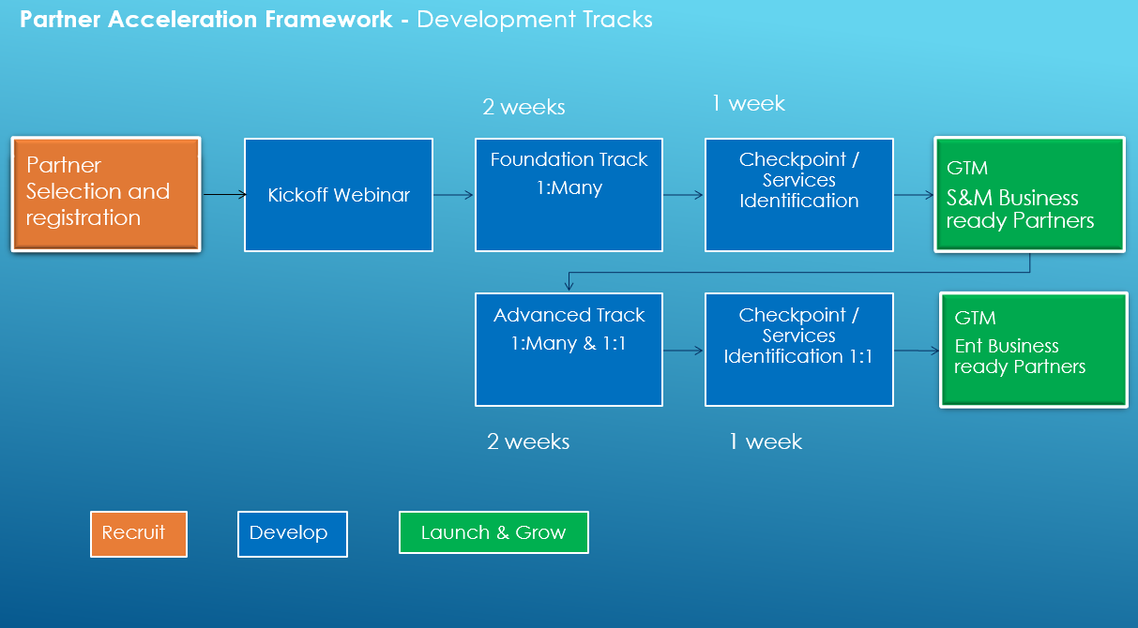
MEA Partner Acceleration Framework

Slide 5
Technical Delivery
Pre-Sales
Title | Link | Duration
Microsoft Azure essentials | https://linuxacademy.com/azure/training/course/name/microsoft-azure-essentials | 5 hours
Azure Migration Overview | https://channel9.msdn.com/Blogs/Hybrid-Cloud/Migration?term=migration | 15 minutes
Azure Migration Deep Dive | https://channel9.msdn.com/events/Ignite/Microsoft-Ignite-Orlando-2017/BRK2233?term=migration | 1 hour
Azure Migrate Service | https://channel9.msdn.com/Shows/Azure-Power-Lunch/AzureMigrateService | 30 minutes
Cost savings with Azure Virtual Machines | https://channel9.msdn.com/events/Ignite/Microsoft-Ignite-Orlando-2017/BRK3178?term=cost | 1.5 hour
Getting started with Azure backup | https://blogs.msdn.microsoft.com/azuregov/2017/02/16/getting-started-with-azure-backup-vaults-policies/ | 1 hour
Cloud Migration Site | https://azure.microsoft.com/en-us/solutions/cloud-migration/ | Reference
Azure Migration Datasheet | https://aka.ms/azuremigration_datasheet | Reference
Azure Migration Overview Guide | https://aka.ms/azuremigration_overview | Reference
DC Transformation Partner Resources | https://www.microsoftpartnerserverandcloud.com/Pages/practice.aspx?page=15 | Reference
Title | Link | Duration
implementing Microsoft Azure Infrastructure Exam 70-533 | https://linuxacademy.com/azure/training/course/name/implementing-microsoft-azure-infrastructure-exam-70-533-prep | 32 hours
Migration to Azure using ASR | https://channel9.msdn.com/events/Ignite/Microsoft-Ignite-Orlando-2017/BRK3243?term=migration | 1 hour
Importing an on-premises VM into Azure | https://channel9.msdn.com/Shows/Azure-Power-Lunch/Importing-an-on-premises-VM-into-Azure | 30 minutes
Azure Site Recovery Deep Dive | https://channel9.msdn.com/Shows/Azure-Power-Lunch/Azure-Site-Recovery | 1 hour
Azure Migration Technical Whitepaper | https://aka.ms/azuremigration_twp | Reference
DC Transformation Partner Resources | https://www.microsoftpartnerserverandcloud.com/Pages/practice.aspx?page=15 | Reference
Azure ASR Architecture | https://docs.microsoft.com/en-us/azure/site-recovery/concepts-vmware-to-azure-architecture | Reference

Slide 6
Migration Framework & Methodologies

Slide 7
What’s Driving Migrations?
Software and hardware refresh
Security threats
Urgent capacity needs
Compliance
Quickly integrate acquisitions
Application innovation
Migration triggers
Software end of support
Datacenter contracts expiry

Slide 8
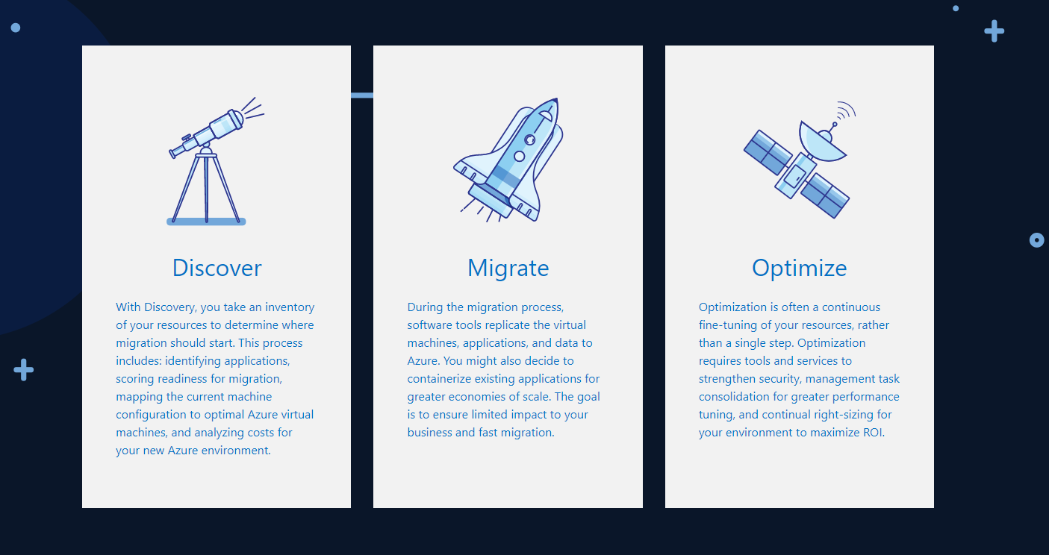
Three Steps Approach

Slide 9
A simpler approach to migration
Assess
Migrate
Optimize
Automated workload and data discovery
TCO and ROI analysis
Recommendation reports
Effortless app, virtual machine, and workload migration to Azure
Convert existing .NET applications to containers
Your choice of Azure database destination
Continual health, performance, and cost management
Access to advanced features in data services
Application analysis for optimal PaaS migration
Notes:
Working with customers and partners, Microsoft has developed a proven approach to migration that reduces risk and increases the chance of both a successful proof of concept and a clear path to additional migration opportunities. Following these steps, you get a clear picture of existing computing resources and dependencies, what will be needed on the Azure side, and what you can expect for costs. More details are on the following pages.

Slide 10
Migration Framework
Assessment
Migrate
Optimize
Discover
Roadmap
Build
Transition
Stabilize
Monitor
Portfolio Assessment
TCO Analysis
Security Requirements
Dependency Mapping
Grouping and Prioritization
Design& Architecture
Detailed Migration Schedule
Tool Selection
Create Azure environment
Replicate via ASR
Integrate applications and networks
Verification
POC Test and QA
User Acceptance
Staging
Cutover and Decommission
Training
Configuration management
ID Management
DevOps Automation
Cloud Monitoring
Cost/Use Optimization
Assessment & Migration tools, Monitoring, Management, Optimization, ITSM & Automation tools
Services Provider Billing and Operations Management & Automation, CSP integration
Notes:
Underneath this there are more details and levers, based on what we’ve seen in the market with other partners Migration Practices as well as what we do in house with our MCS Migration Practice
We’re currently developing the technical IP to guide partners on how to deliver on all of these steps, as well as the tooling to use (we’ll provide some subsidized licensing perhaps)
Provides a structure for delivering a broad portfolio of strategic guidance and tactical engagement of resources to drive realization of modern, digital, cloud-enabled and cloud-resident services and systems.

Slide 11

Types of Migrations
Rehost:
i.e. redeploy applications to a different (newer) hardware environment. Rehosting an application
without making changes to its architecture can provide a fast cloud migration solution. IaaS
Refactor:
i.e. run applications on a cloud provider’s infrastructure. Applications/workloads may need to be
modified slightly to run on the cloud provider’s platform. PaaS / Containers
Revise:
i.e. modify or extend the existing code base to support modernization requirements,
then use rehost or refactor options to deploy to cloud.
Rebuild:
i.e. rearchitect the solution. Discard code of existing application/solution and leverage newer
and innovative cloud services (like PaaS)
i.e. discard an existing application (or set of applications) and use commercial software
delivered as a service (SaaS)
Replace:
Retire/Retain:
i.e. discard completely or do not move. Some applications may not be used by anyone or
others may be simply impossible to move!

Slide 12
A different view of our Tactical approach
Approach:
From…
Office servers
Portals and SPS
Any relationship mgmt
Active source control
Data warehouses
Industry standard verticals
…To
Office 365
SharePoint Online
CRM Online
VSTS
ADL + PowerBI
Best 3rd-party SaaS
Retire it, right-size, eliminate environments
30%
Use or convert to a SaaS (1st or 3rd party) solution
15%
Use or convert to a SaaS (1st or 3rd party) solution
Expose functionality in existing SaaS/PaaS solution
Azure IT roadmap
Convert to Azure PaaS solution
First to move
Basic web apps
Advanced portals
Any new solutions
Any re-architected solutions
Next to move
High I/O OLTP
Regulatory and high business impact
50%
Optimize for and move to Azure IaaS VM
No change, lift ‘n shift to IaaS
Remain on-premises
HVA systems
PKI systems
Legacy source control
5%

Slide 13
Lift and Shift (Apps, Virtual Machines, Workloads)
Lift and Shift is great when you
Want to avoid the burden of owning on-premises servers and datacenters. The cost and risk of maintaining the facilities are high.
Want to move to cloud to lower your maintenance costs by taking advantage of cloud infrastructure.
Need a scale-on-demand capacity with no change in application environment needed.
Want to have data disaster recovery in cloud.
Notes:
There are many scenarios under which Lift and Shift is the best approach:
Want to move to Cloud as-is to lower your maintenance costs taking advantage of cloud infrastructure
Want to avoid the burden of owning on-premises servers and data centers.
Need a scale-on-demand capacity with no change in application environment needed.
Need disaster recovery

Slide 14


Understanding a Typical On-Premise to Cloud Migration
MIGRATION PROCESS
DECOMMISSION
Azure
Hybrid
Partner cloud
Customer Cloud
1.
1
Discover customer’s
on-prem footprint (VMs, networks, apps etc.)
2
Map dependencies and determine network topology
3
Recommend optimization path for workloads, cost modeling
4
Determine best cloud computing service model
5
Provide cloud migration strategy and plan

Slide 15
Partner Offering Progression
Managed Services based recurring revenue
Advanced Managed Services
(Big Data, Advanced Analytics/AI, Dev Ops, IoT)
Workload optimization
(e.g.: IaaS – PaaS, Application re-architecture)
Capacity & Capability
Cloud workload management services
(e.g.: Monitoring, Support, Security)
PARTNER’S AZURE MIGRATION OFFERING JOURNEY
Assessment & Migration
(Lift & Shift, Redeploy, DR)
Offering progression over time
*Source: HMSP partner interviews; partner may team up with SI/subcontract

Slide 16


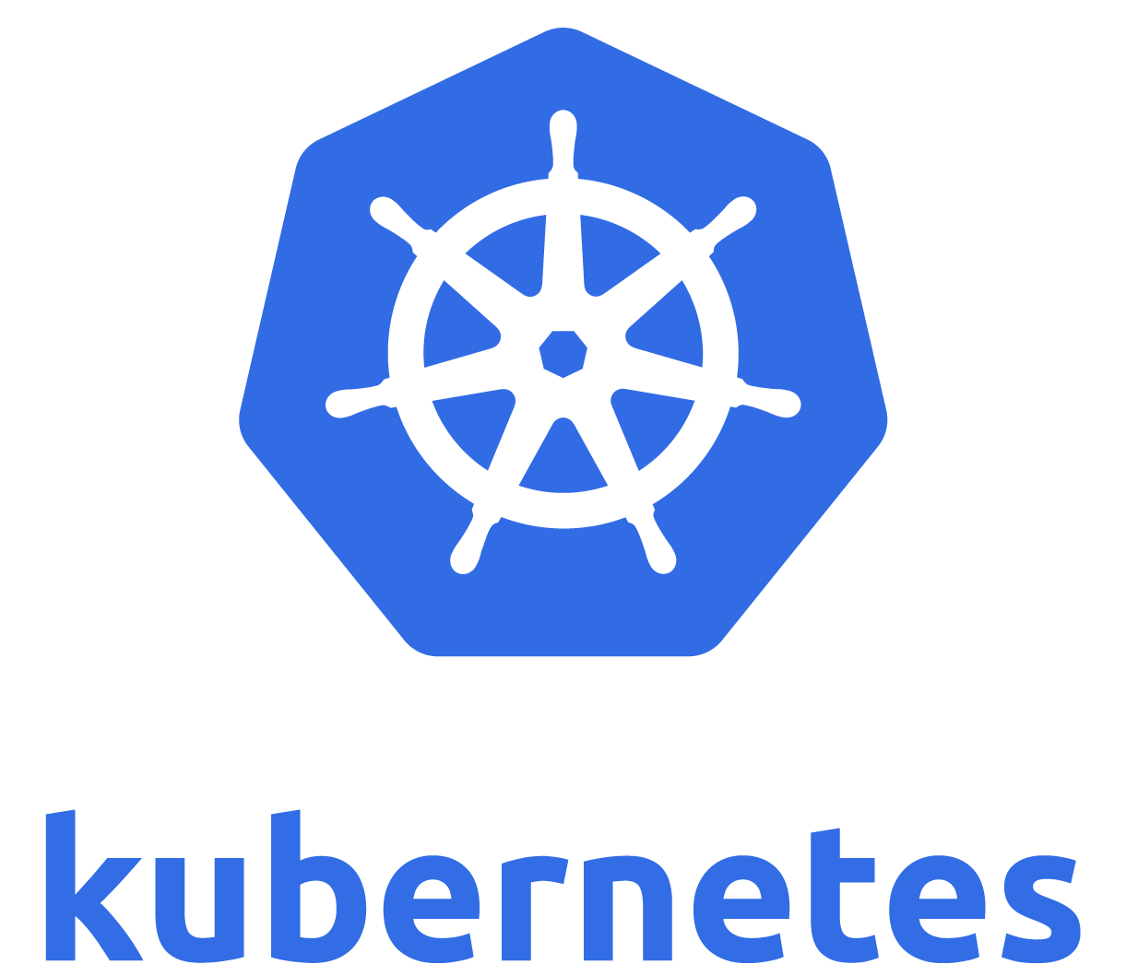
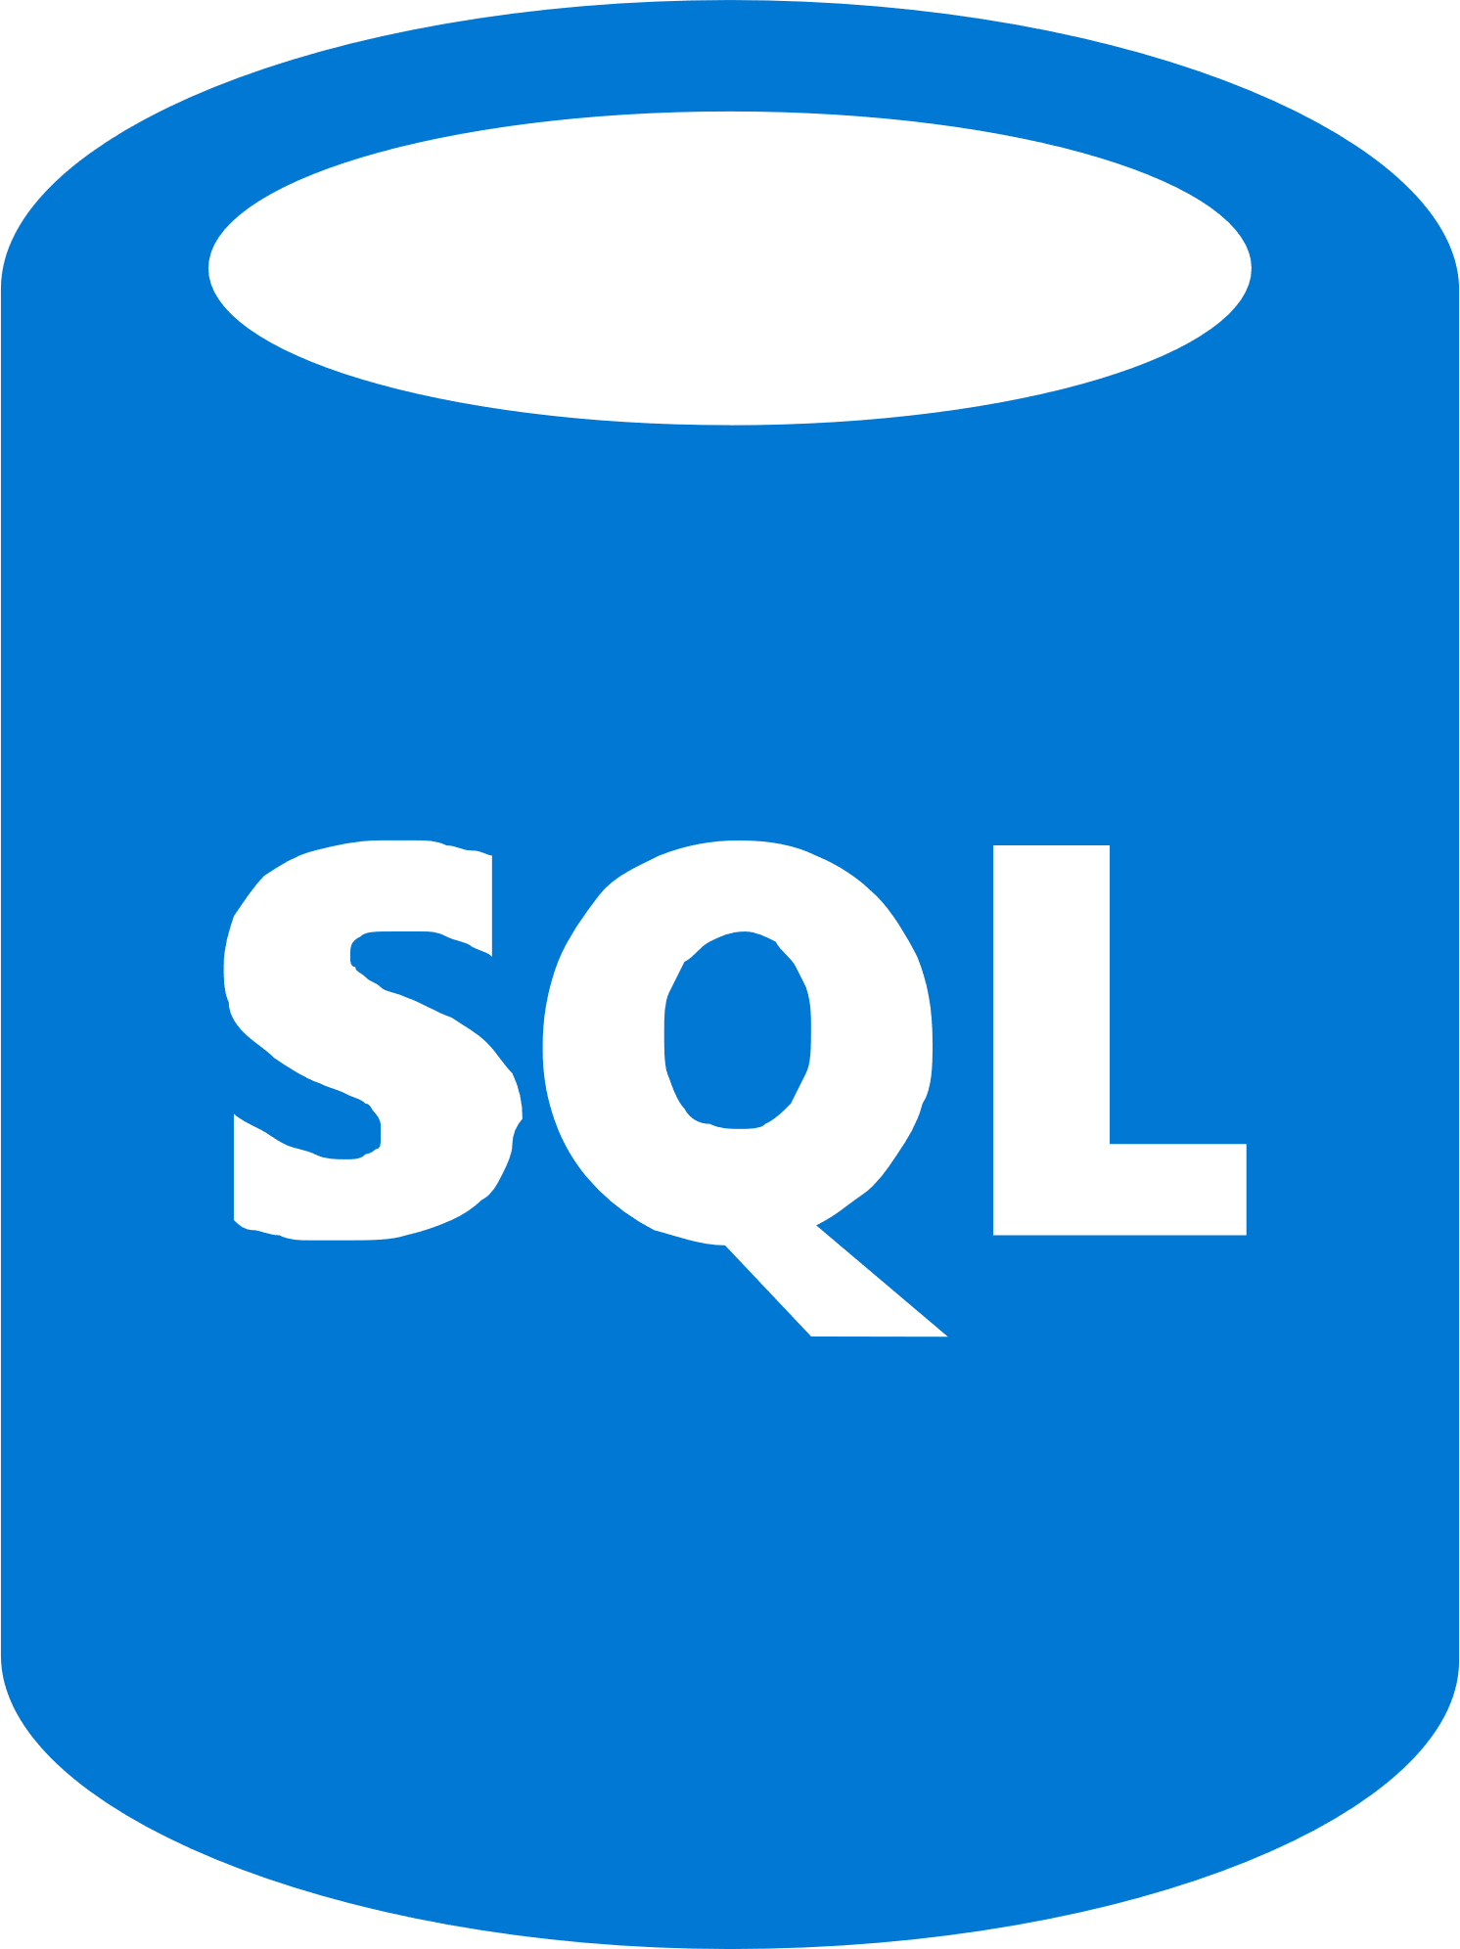
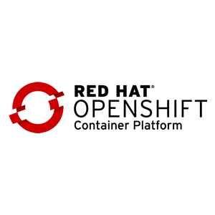
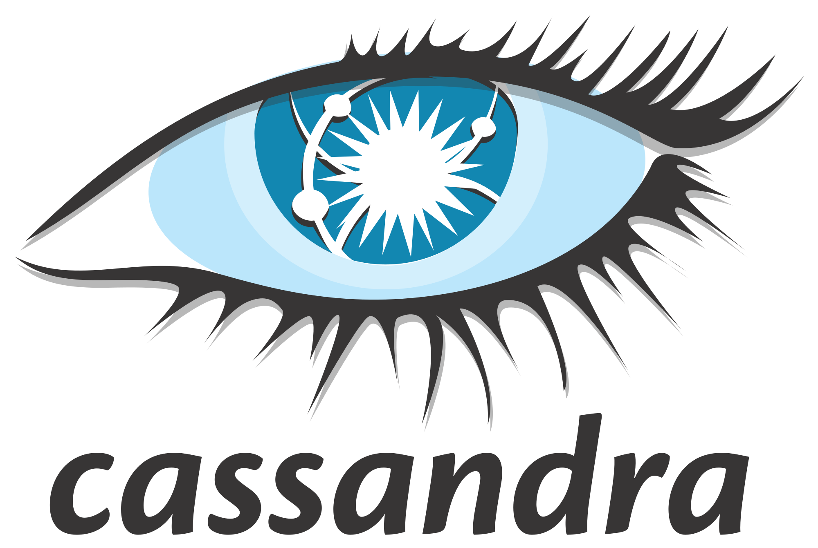


Azure Continues to Innovate
Azure Migrate to assess Windows and Linux VMs on VMware
Deep Java and Tomcat support in Azure App Service
Azure Database for PostgreSQL, MySQL, and MariaDB
Azure Site Recovery for Windows and Linux migration
Windows / Linux containers on Azure App Service, Kubernetes on Azure
Azure SQL Database Managed Instance
Azure Database Migration Service for SQL Server and My/ Postgre/No-SQL migration
Red Hat Enterprise Linux & Red Hat OpenShift
Cassandra and Mongo DB support in Azure Cosmos DB

Slide 17
Azure Migration Journey
Migrate*
Rehost
lift-and-shift
Refactor
Assess
Optimize
Rearchitect
Rebuild
*These migration strategies are adopted from Gartner research. Gartner also calls out a 5th strategy called “Replace” with SaaS

Slide 18







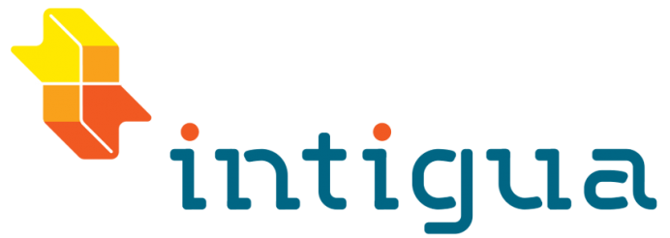
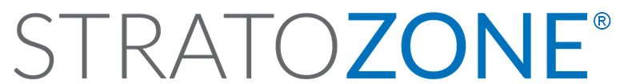






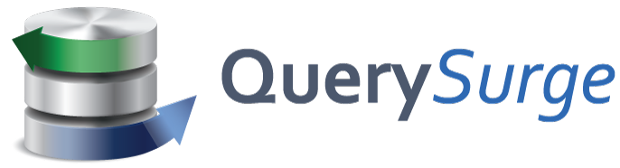
Tools for Every Stage
Microsoft
Assess
Migrate
Optimize
Azure Migrate
Azure Site Recovery
Azure security and management (security, backup, monitoring, cost management)
Data Migration Assistant
Azure Database Migration Service
SQL Server Migration Assistant
Azure Data Box
Partners

Slide 19
Discover and Assess
with Azure Migrate

Slide 20


Azure Migrate for Discovery and Assessment
What does it do?
Easily discover on-premises VMs and applications, including application dependencies
Insightful workload assessments:
Right-sized Azure resources based on utilization history
Estimated monthly run costs in Azure
Migration risks and recommended tools
Roadmap
Hyper-V & physical server discovery and assessment
Built-in migration experience
Azure

Slide 21



How Azure Migrate Works
Raw metadata
Processed metadata
Appliance
HTTPS, 443
Azure Migrate Service
Assessment
2. Start discovery
3. Create assessment
Raw metadata
443
vCenter Server
1. Download and configure appliance
Customer
vSphere server and VMs
Documentation: http://aka.ms/azuremigrate/documentation
Videos: https://aka.ms/migrate/video

Slide 22
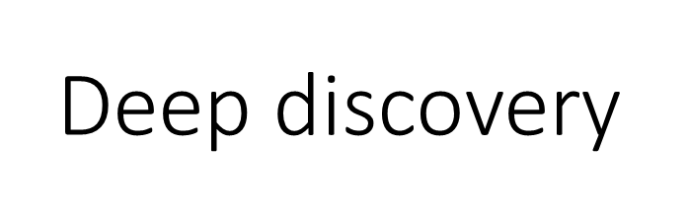
Light discovery
Appliance-based
No pre-setting or pre-configuring a machine
No installation of pre-requisite software
No agents to install and no firewall ports to open
No machine creds (host or guest)
No privileged creds (virtualization manager)
No waiting to gather performance history
Agent-based
No guesswork anymore
No need to remember which machine belongs to which app

Slide 23

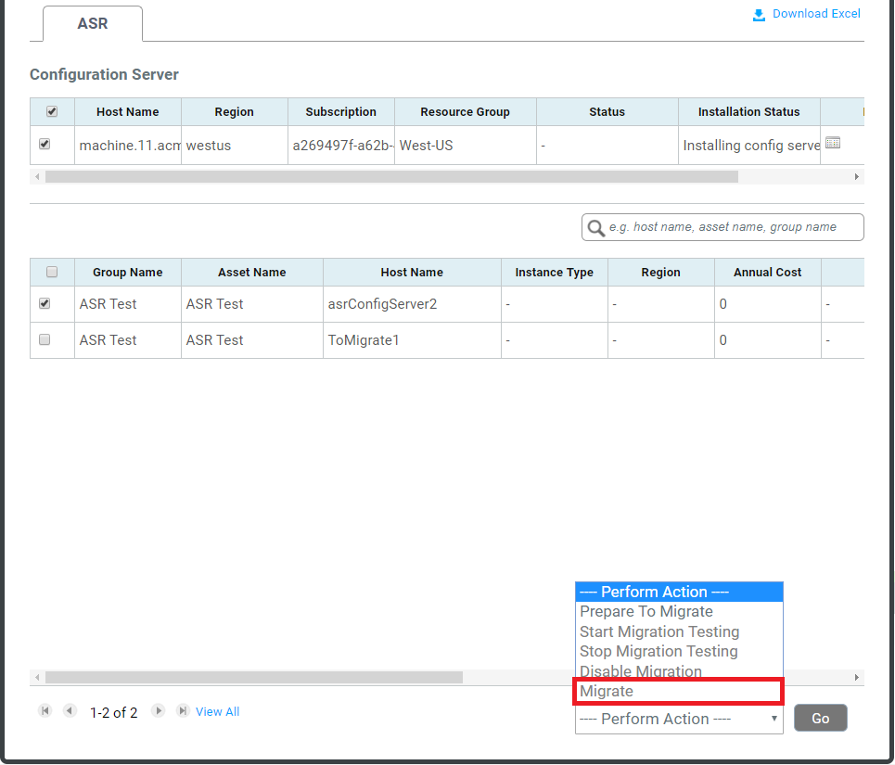
Migration to Azure with Cloudamize
Integration with ASR allows seamless migration via Cloudamize Platform
Download ASR Readiness Report to identify and reconcile potential blockers
Prepare infrastructure for ASR migration including setting up ASR configuration server and mobility service in just a few clicks
Execute tests and replication via the Cloudamize Platform and track migration status

Slide 24
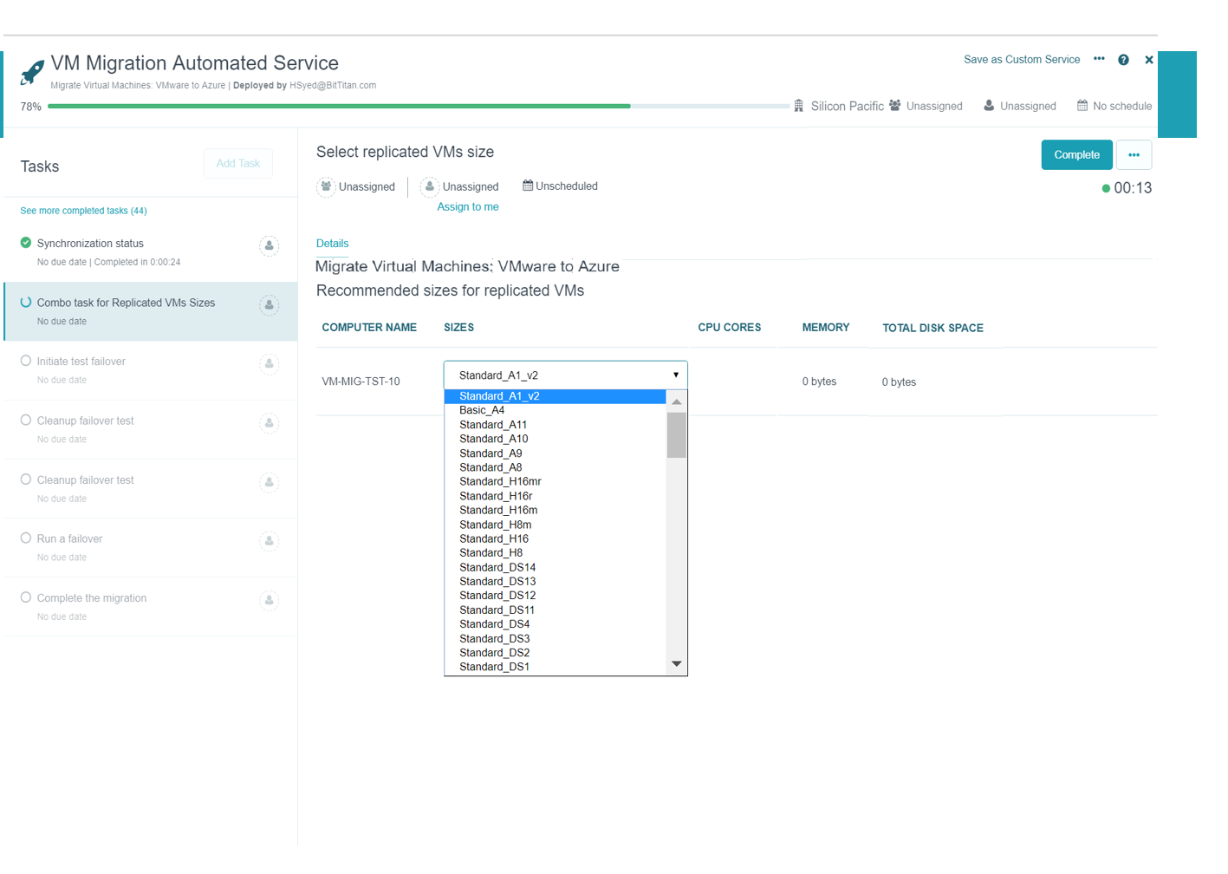
Migration to Azure with BitTitan
Support for discovery, assessment and planning using BitTitan capabilities
Prepare infrastructure for ASR migration including setting up ASR configuration server and mobility service in just a few clicks
Migration and cutover to Azure using Azure Site Recovery integration

Slide 25
Demo
Azure Migrate
Discovery, Assessment, Cost Planning

Slide 26
Recent Enhancements
Sizing | Target location Performance-based sizing ^{NEW} As on-premises sizing ^{NEW} Option to specify VM series ^{NEW} Option to specify storage type for Single VM SLA ^{NEW} Confidence rating
Cost estimation | Azure Hybrid Benefit Azure Offers Custom Discount Currency ^{NEW} Reserved Instances ^{NEW} VM uptime
Migration target locations | Azure commercial regions ^{NEW} Azure Government, Germany and China
Azure platform support | Managed Disk Up to 4TB data disk support ^{NEW} Windows Server 2008 (32 & 64-bit support)
Support Matrix
https://aka.ms/migrate/targetregions

Slide 27
Customer Considerations for Assessment Tools
Is the tool a Microsoft tool? More importantly, is there a free option?
Can I discover my infrastructure and perform assessments without installing an agent?
Can the same tool work for VMware, Hyper-V, physical servers, and more?
Can the tool find my application dependencies and group them?
Can the tool connect to other inventory sources such as Active Directory or CMDBs?

Slide 28
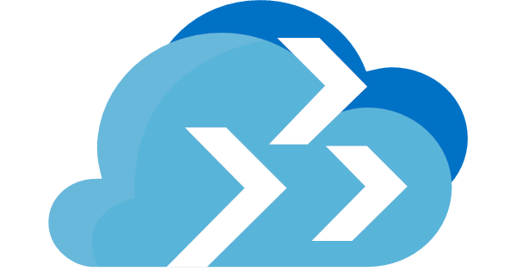

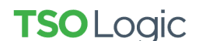


Customer Considerations for Assessment Tools
Microsoft tool – free option
Agentless discovery and assessments
Heterogenous (VMware, Hyper-V & physical servers)
Application dependency mapping
Import from CMDB and other sources
Azure Migrate
Azure Migrate
Azure Migrate
Tools listed are recommendations, but not an exhaustive list.
See azure.com/migration/partners for the full list.

Slide 29




Choosing Between Microsoft and ISV Tools
Use Azure Migrate when customer needs…
Use ISV tools when customer needs…
A Microsoft Azure branded tool which is free
Assessment of heterogeneous environments
(physical, VMware and Hyper-V)
Assessment of VMware environments¹
Agentless dependency visualization
Assessments of brand new Azure platform functionality
¹ Support for Hyper-V and physical servers is coming soon
Tools listed are recommendations, but not an exhaustive list.
See azure.com/migration/partners for full list.

Slide 30



Assessment Tools Comparison
Criteria
Free
Agentless data collection
Support for VMware
Support for Hyper-V | Coming soon
Support for Physical servers | Coming soon
Dependency visualization |  |  |  | leverages 3rd-party tools
Right-sizing and cost estimation
Agentless dependency visualization
Reserved instance-based pricing
Granular cost analysis
Support for new Azure SKUs as they roll out
Azure Migrate

Slide 31
Migrate VMs and Servers
with Azure Site Recovery

Slide 32
Azure Site Recovery for Server Migration
What does it do?
Effortless migration of VMs and apps to Azure
Zero application data loss during migration
Near-zero application downtime during migration
Broad coverage for hypervisors, applications, operating systems, and Azure features
No-impact application testing in Azure
Free usage during migration
Roadmap
OS-agnostic, agentless migrations to Azure
Integration with discovery and assessment
Azure

Slide 33




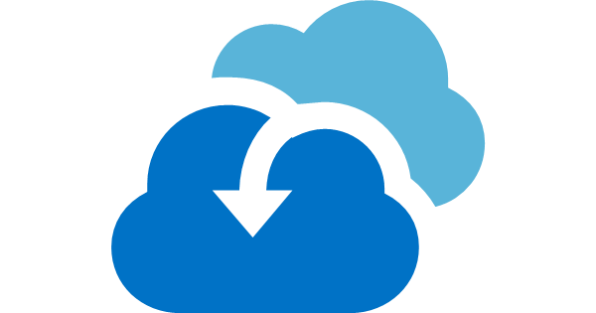


How Hyper-V Migration Works
443 (HTTPS)
Microsoft Azure
Data Channel
Public Internet or ExpressRoute with Public Peering
Source: Hyper-V
Microsoft Azure Recovery Services Agent
Replicates data to Azure
Documentation: https://aka.ms/asr_hyperv
Videos: https://aka.ms/asr_videos

Slide 34

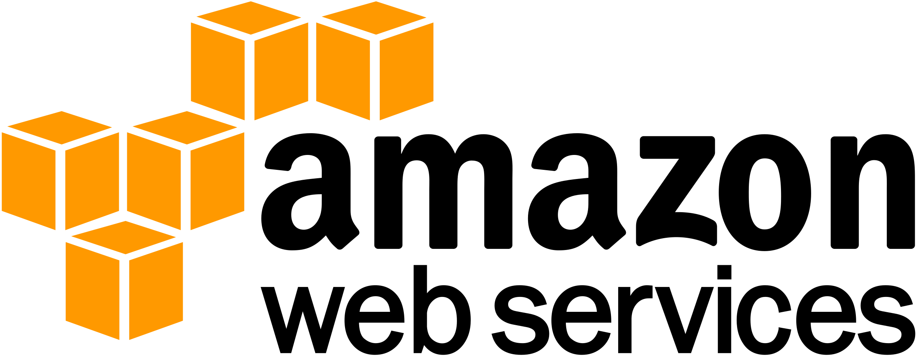



How VMware Migration Works
Config Server
Process Server
443 (HTTPS)
9443 (HTTPS)
Microsoft Azure
443 (HTTPS)
Microsoft Azure
Data Channel
Public Internet or ExpressRoute with Public Peering
Source: VMware, AWS, Physical Servers
Process Server
Used for caching, compression, and encryption
Configuration Server
Used for centralized management
Mobility Service Captures all data writes from memory
Documentation: http://aka.ms/asr_vmware
Videos: https://aka.ms/asr_videos

Slide 35
Comprehensive Coverage for VMware
vCenter Server and vSphere support | 6.5, 6.0, ^{NEW}6.7, 5.5
Windows Guest OS support | Windows Server 2016 Windows Server 2012 R2 Windows Server 2012 Windows Server 2008 R2 ^{NEW} Windows Server 2008 (32-bit and 64-bit)
Linux Guest OS support | RHEL 5.*, 6.* and 7.* Cent OS 5.*, 6.* and 7.* Ubuntu 14.04 and 16.04 LTS ^{NEW} SUSE Enterprise Server 12 SP1, SP2, SP3 SUSE Enterprise Server 11 SP3, SP4, 12 SPI OEL 6.4 and 6.5 Debian 7 and 8 support
Azure platform support | Managed Disk Up to 4TB data disk support Encrypted Storage Azure Hybrid Benefit for Windows Server
Support Matrix
https://aka.ms/asr_supportmatrix
NOTE: Hyper-V Migration with Azure Site Recovery supports every Windows and Linux OS that is endorsed to run on the Azure Compute platform

Slide 36



Zero Application Data Loss
Test Performance
Plan and Notify
Take App Offline
Migrate to Azure
Resume
App

Slide 37
Customer Considerations for Migration Tools
Is the tool a Microsoft tool? More importantly, is there a free option?
Can I migrate Windows and Linux servers to Azure?
Can the same tool work for VMware, Hyper-V, and physical servers?
Can I perform migrations without running an appliance in Azure?
Can I perform migrations without installing an agent on my servers?

Slide 38

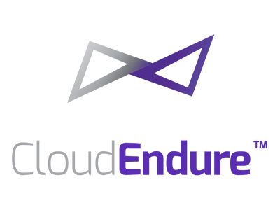

Customer Considerations for Migration Tools
Microsoft tool – free option
Windows and Linux
VMware, Hyper-V, physical servers
No appliance needed in Azure
No agent needed on servers
Azure Site Recovery
Azure Site Recovery
Azure Site Recovery
Azure Site Recovery
Tools listed are recommendations, but not an exhaustive list.
See azure.com/migration/partners for the full list.

Slide 39


Choosing Between Microsoft and ISV Tools
Use Azure Site Recovery (ASR) when customer needs…
Use ISV tools when customer needs…
A Microsoft Azure branded tool which is free
OS-agnostic coverage
Migration of Windows and Linux workloads
(covering most versions and distros)
Agentless migration solution
Support for new Azure SKUs as they roll out
Tools listed are recommendations, but not an exhaustive list.
See azure.com/migration/partners for full list.

Slide 40

Migration Tools Comparison
Criteria
Free
Agentless migration solution | Coming soon
Support for VMware
Support for Hyper-V
Support for Physical servers
OS-agnostic coverage | Coming soon
No replication server needed in Azure
Support for new Azure SKUs as they roll out

Slide 41
Hyper-v and Physical Servers

Slide 42
ASR deployment Planner for Hyper-v
VM eligibility assessment, based on the number of disks, disk size, IOPS, churn, and a few VM characteristics
Network bandwidth need versus RPO assessment
Azure infrastructure requirements
On-premises infrastructure requirements
Initial replication batching guidance
Estimated total disaster recovery cost to Azure

Slide 43
ASR Deployment Planner
Site Recovery Deployment Planner is a command-line tool for both Hyper-V to Azure and VMware to Azure disaster recovery scenarios.
Get the Virtual machine list
Profile
Generate a Report
Get throughput

Slide 44
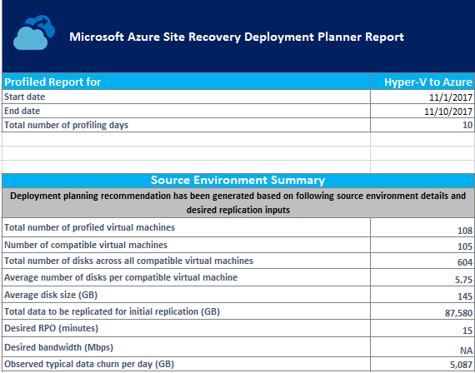
ASR Deployment Planner

Slide 45
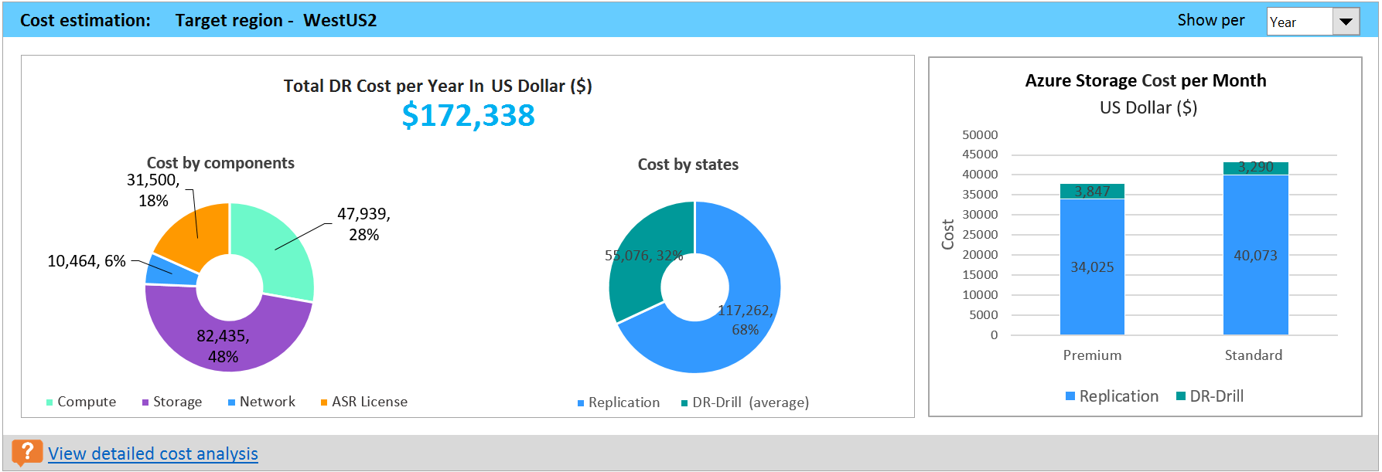
ASR Deployment Planner

Slide 46
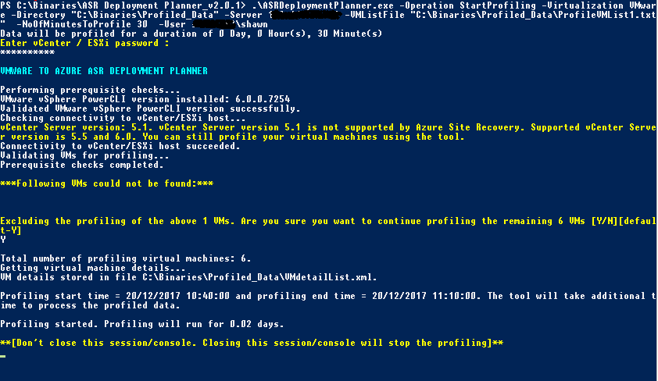
ASR Deployment Planner

Slide 47
Physical Servers
Manual Calculations – Perf counters
MAP

Slide 48
Performance counters
1- Memory ( pages/ sec )
2- Memory ( Available Mbytes )
3- Memory ( Cache Bytes )
4- Memory ( Pool NonPaged Bytes)
5- Network ( Bytes Received / sec )
6- Network ( Bytes Sent / sec )
7- Processor ( % processor Time )
8- Disk Read bytes / sec
9- Disk Read / sec
10- Disk Write bytes / sec
11- Disk Writes / sec

Slide 49
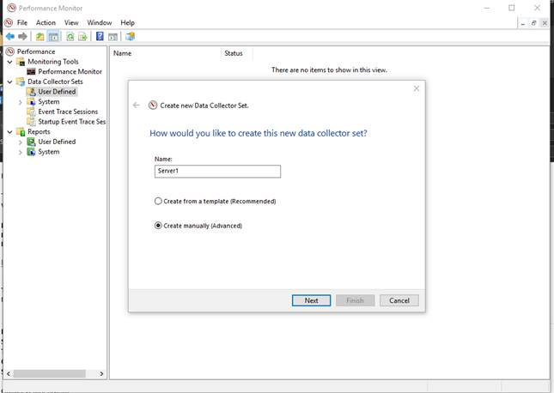
Performance counters

Slide 50
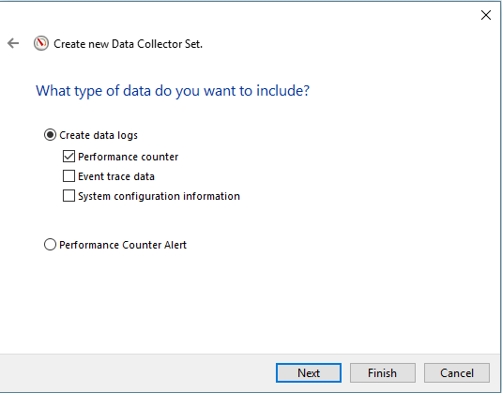
Performance counters

Slide 51
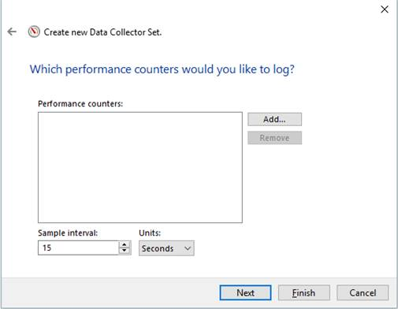
Performance counters

Slide 52
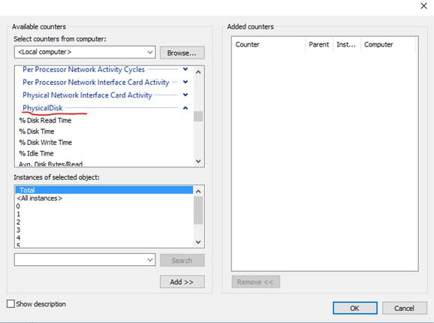
Performance counters

Slide 53
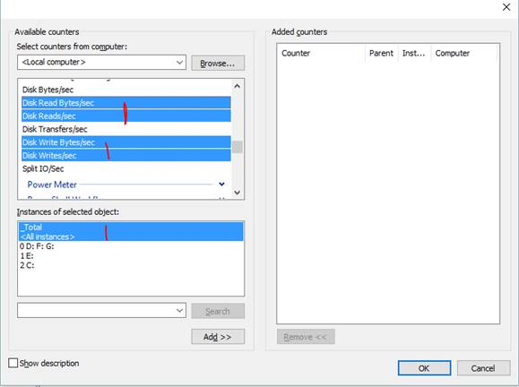
Performance counters

Slide 54
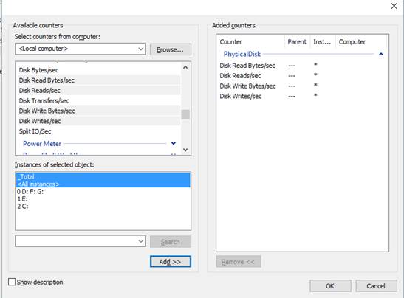
Performance counters

Slide 55
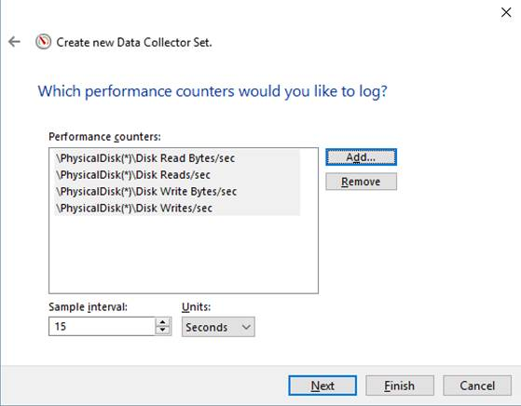
Performance counters

Slide 56
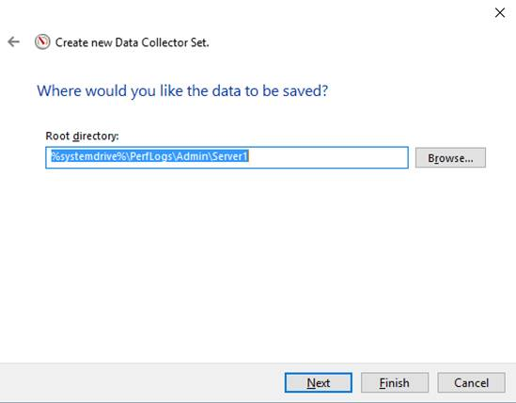
Performance counters

Slide 57
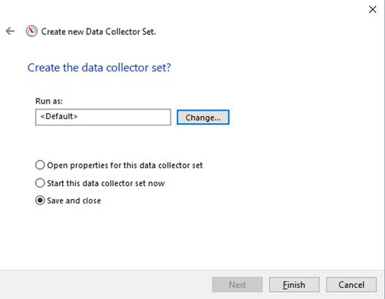
Performance counters

Slide 58
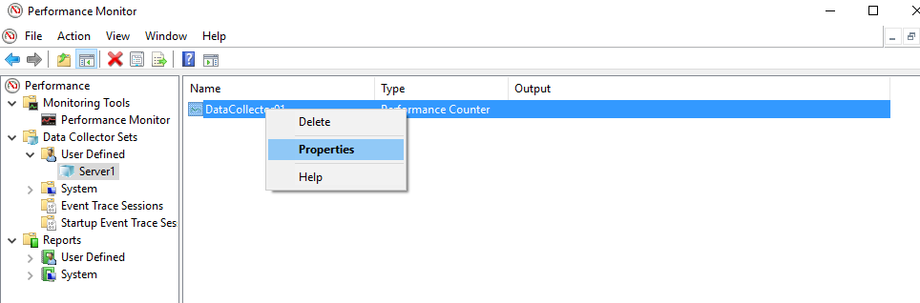
Performance counters

Slide 59
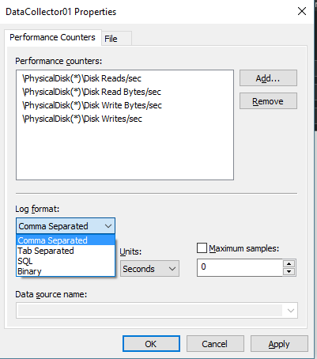
Performance counters

Slide 60
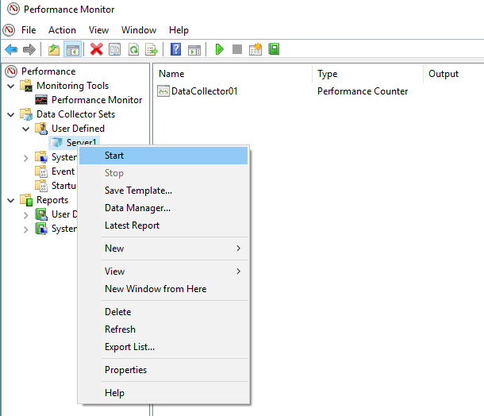
Performance counters

Slide 61
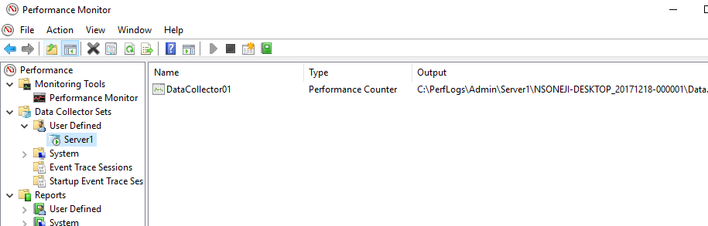
Performance counters

Slide 62
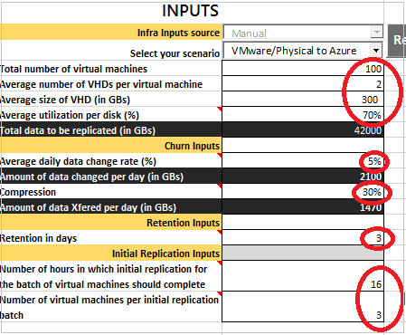
Site Recovery Capacity planner
Site recovery capacity
planner
ASR Disk IO limits

Slide 63
Microsoft Assessment and planning tool kit https://www.microsoft.com/en-us/download/details.aspx?id=7826
MAP Toolkit

